Slide 1
STRATEGIC MARKETING
Marketing Mix:
Pricing Strategies
Prof. Mohammed Rafiq
Professor of Marketing

Slide 2
Pricing : understanding and capturing customer value
Topic outline
What is a price?
Major pricing strategies
Internal and external considerations affecting price decisions.
New product pricing strategies
Product mix pricing strategies
Price adjustment strategies

Slide 3


Which one is Miu Miu £785 and which is Primark £8.50

Slide 4
What is a price?
Price is the amount of money charged for a product or service; the sum of the values that consumers exchange for the benefits of having or using the product or service.

Slide 5
What is a price? (Continued)
Price is the only element in the marketing mix that produces revenue; all other elements represent costs.

Slide 6
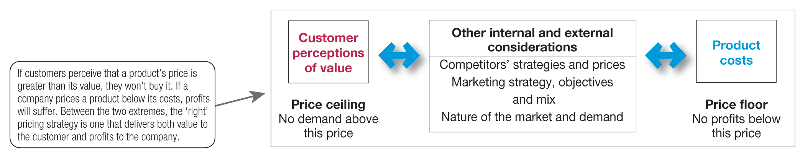
Major pricing strategies

Slide 7
Overall Marketing Strategy and Pricing
Before setting Prices company must decide overall marketing strategy
Pricing is only one element of the Market Mix
Positioning is key in determining product price

Slide 8
Major pricing strategies (Continued)
Cost-based pricing
Cost-based pricing involves setting prices based on the costs for producing, distributing and selling the product plus a fair rate of return for effort and risk.

Slide 9
Major pricing strategies (Continued)
Cost-based pricing
Types of costs
Fixed costs
Variable costs
Total costs

Slide 10
Major pricing strategies (Continued)
Cost-plus pricing
Cost-plus pricing adds a standard markup to the cost of the product.
Benefits
Sellers are certain about costs.
Prices are similar in industry and price competition is minimised.
Buyers feel it is fair.
Disadvantages
Ignores demand and competitor prices.

Slide 11
Major pricing strategies (Continued)
Competition-based pricing
Setting prices based on competitors’ strategies, prices, costs and market offerings.
Consumers will base their judgements of a product’s value on the prices that competitors charge for similar products.

Slide 12
Major pricing strategies (Continued)
Customer value-based pricing
Understanding how much value consumers place on the benefits they receive from the product and setting a price that captures that value.

Slide 13
Major pricing strategies (Continued)
Customer value-based pricing
Value-based pricing uses the buyers’ perceptions of value, not the seller’s cost, as the key to pricing. Price is considered before the marketing programme is set.
Value-based pricing is customer driven.
Cost-based pricing is product driven.

Slide 14
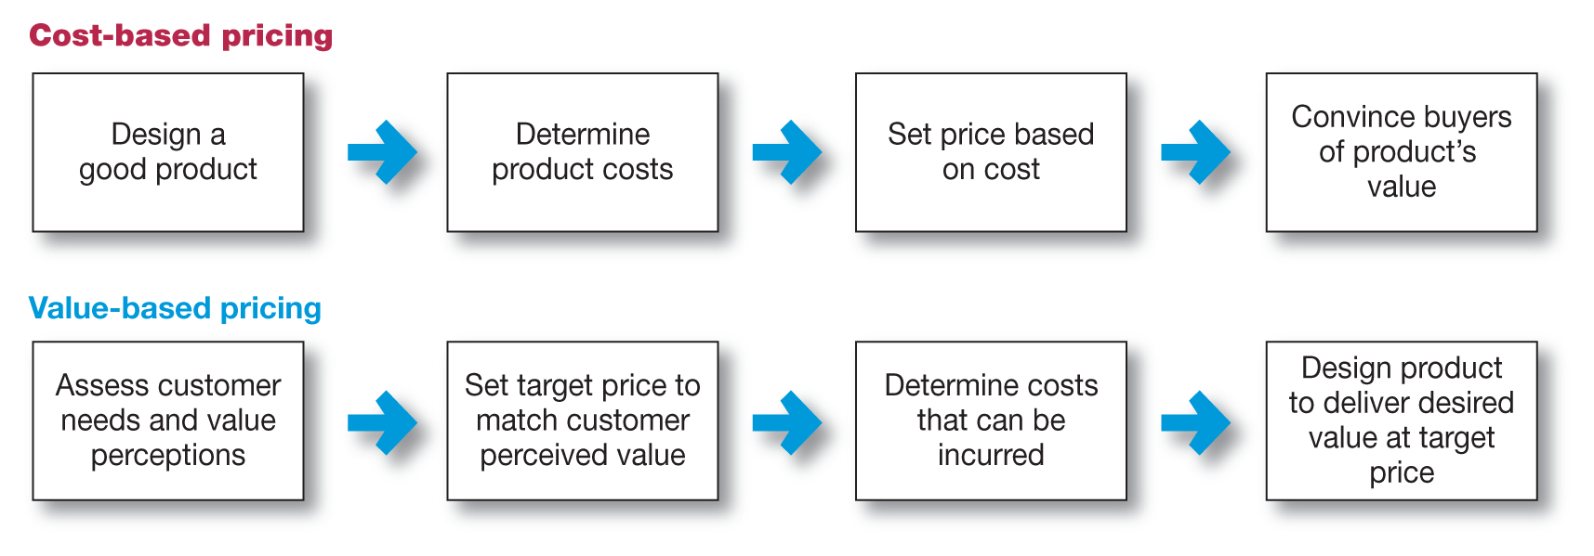
Major pricing strategies (Continued)
Value-based pricing versus cost-based pricing

Slide 15
Major pricing strategies (Continued)
Customer value-based pricing
Good-value pricing offers the right combination of quality and good service at a fair price.

Slide 16
Major pricing strategies (Continued)
Customer value-based pricing
Everyday low pricing (EDLP) involves charging a constant everyday low price with few or no temporary price discounts.

Slide 17
Major pricing strategies (Continued)
Customer value-based pricing
High–low pricing involves charging higher prices on an everyday basis but running frequent promotions to lower prices temporarily on selected items.

Slide 18
Major pricing strategies (Continued)
Customer value-based pricing
Value-added pricing attaches value-added features and services to differentiate a company’s offers and charging higher prices.

Slide 19
Other internal and external considerations affecting price decisions (Continued)
The market and demand
Before setting prices, the marketer must understand the relationship between price and demand for its products.

Slide 20
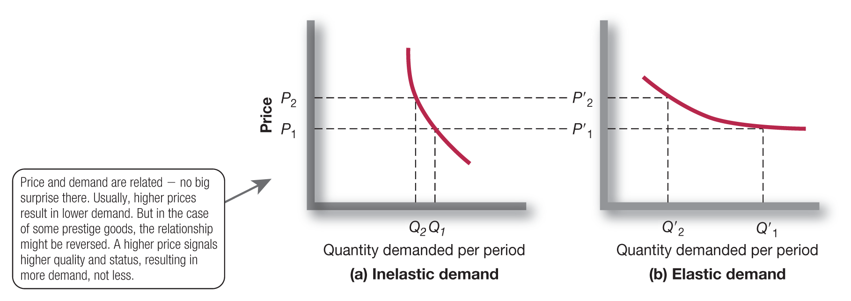
Other internal and external considerations affecting price decisions (Demand Curves)

Slide 21
Other internal and external considerations affecting price decisions (Price Elasticity)

Slide 22
Other internal and external considerations affecting price decisions (Continued)
Types of Competition
Pure competition
Monopolistic competition
Oligopolistic competition
Pure monopoly

Slide 23
New product pricing strategies
Market-skimming pricing
Market-penetration pricing.

Slide 24
New product pricing strategies (Continued)
Market-skimming pricing is a strategy with high initial prices to ‘skim’ revenue layers from the market.
Product quality and image must support the price.
Buyers must want the product at the price.
Costs of producing the product in small volume should not cancel the advantage of higher prices.
Competitors should not be able to enter the market easily.

Slide 25
New product pricing strategies (Continued)
Market-penetration pricing sets a low price for a new product to attract a large number of buyers and a large market share.
Price sensitive market.
Inverse relationship of production and distribution cost to sales growth.
Low prices must keep competition out of the market.

Slide 26
Product mix pricing strategies
Product line pricing
Optional- product pricing
Captive- product pricing
Product bundle pricing

Slide 27
Product mix pricing strategies (Continued)
Product line pricing takes into account the cost differences between products in the line, customer evaluation of their features and competitors’ prices.
Optional-product pricing takes into account optional or accessory products along with the main product.

Slide 28
Product mix pricing strategies (Continued)
Captive-product pricing involves products that must be used along with the main product.

Slide 29
Product mix pricing strategies (Continued)
Product bundle pricing combines several products at a reduced price.

Slide 30
Price adjustment strategies and the Internet
Dynamic pricing/ Real Time Pricing is when prices are adjusted continually to meet the characteristics and needs of the individual customer and situations.
Auctions/ Price bidding is when price is determined by the highest bid e.g. eBay

